Slide 1
Create and Configure Spring Boot E-Store Java Backend Project

Slide 2
Create Spring Boot Project

Slide 3





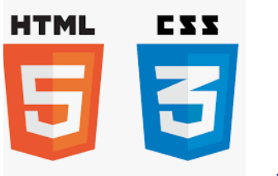

Before we begin, let’s recall what we have covered till now:
Agile
Git
SQL
Angular
HTML
CSS
JavaScript
CoreJava

Slide 4





Before we begin, let’s recall what we have covered till now:
JDBC
JSP
Servlets
MongoDB
Maven

Slide 5



Before we begin, let’s recall what we have covered till now:
JUnit
Spring
Spring Boot

Slide 6
HTTP Request and Response with Servlets
Develop Servlets and implement HTTP Request Response Structure
Perform CRUD Operations with doGet, doPost, doPut, and doDelete methods
MySQL Connectivity
Use implemented DAO Java Classes
Perform DB CRUD operations in servlets

Slide 7
JSON Response
Use Google GSON
Send JSON as a response from Servlets
Unit Testing
Configure JUnit
Implement Test Cases using JUnit

Slide 8
As a full stack web developer, our key role is to develop both client and server software.
Angular and Node can be used to build front end of the web page.
Spring Boot, Java, and MySQL or MongoDB can be used to build at the back end.

Slide 9

Bob needs to create and configure his backend project. So, Bob brainstorms a bit and finds a solution.
Let me use spring, spring boot, webservices, and microservices to create a spring boot project and spring web and JDBC dependencies to configure this project.
In this lesson, we will implement CRUD Operations with JDBC in the microservices using RestController and CrudRepository APIs from Spring Framework Data Package and help Bob to complete his task effectively and quickly.

Slide 10

Create spring boot project
Configure web and JDBC dependencies in spring boot
Create repository for implementing CRUD operations
Build and run backend project on tomcat localhost 8080

Slide 11
Create Spring Boot Project in Eclipse

Slide 12
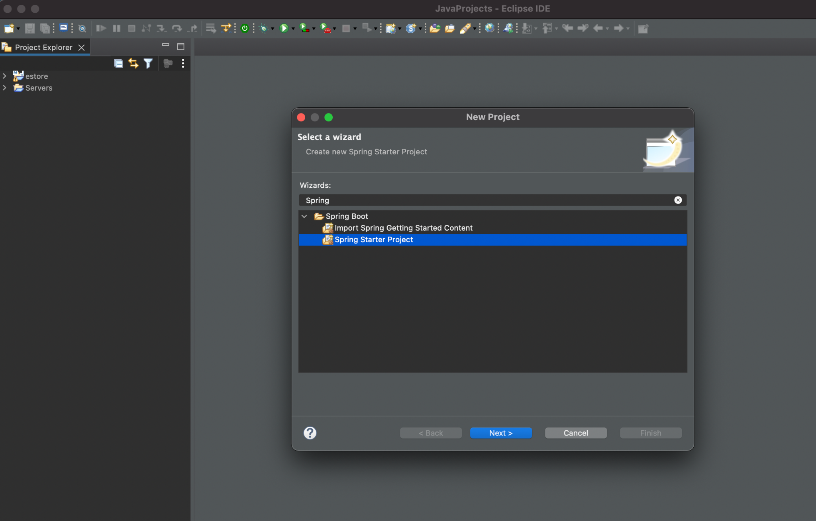
Create Spring Boot Project
To create a Spring Boot project in Eclipse, install Spring Tool Suite from Eclipse Market Place.
Go to File > New > Project > Spring Starter Project
Notes:
In order to create a Spring Boot project in Eclipse, firstly you need to install Spring Tool Suite from Eclipse Market Place.
Than create a Spring Boot Project. File > New > Project > Spring Starter Project

Slide 13
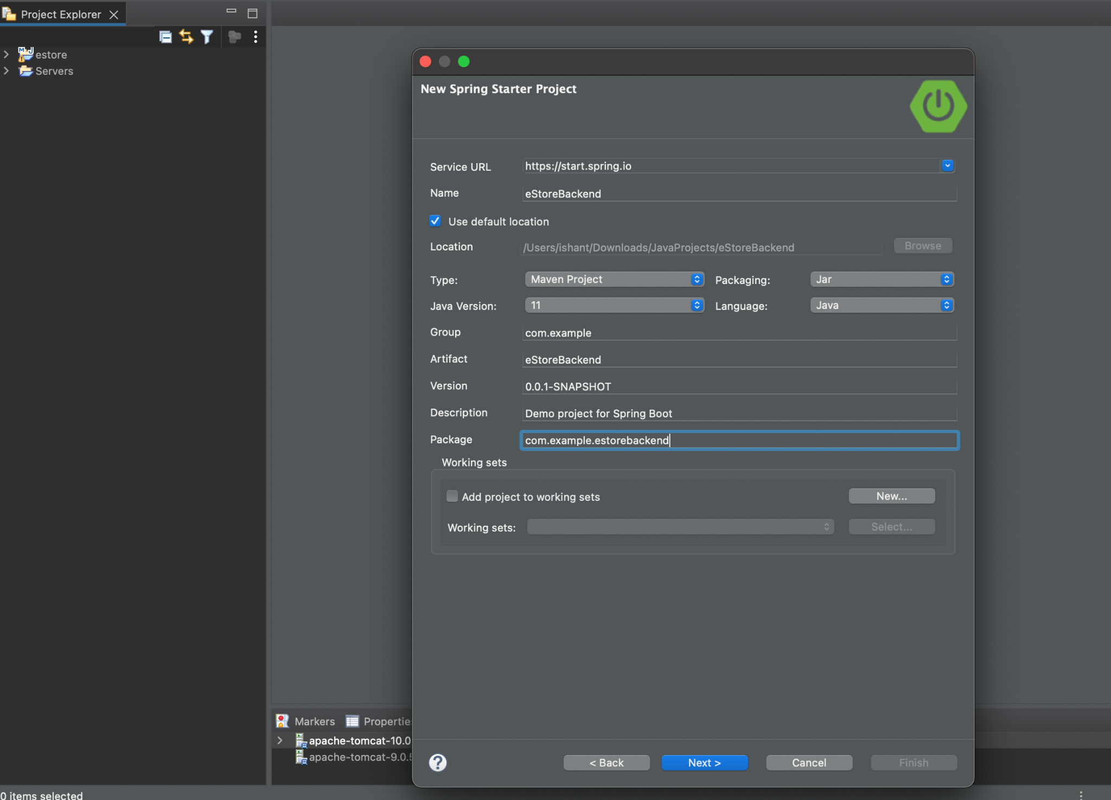
Create Spring Boot Project
Fill in the details like name, group id, artifact, and package.
Notes:
Now, fill in the details like name, group id, artifact and package.
Select the build type as Maven and suitable version of Java. In our case we have selected java 11
Select the packaging as jar, and than proceed further by clicking on next

Slide 14
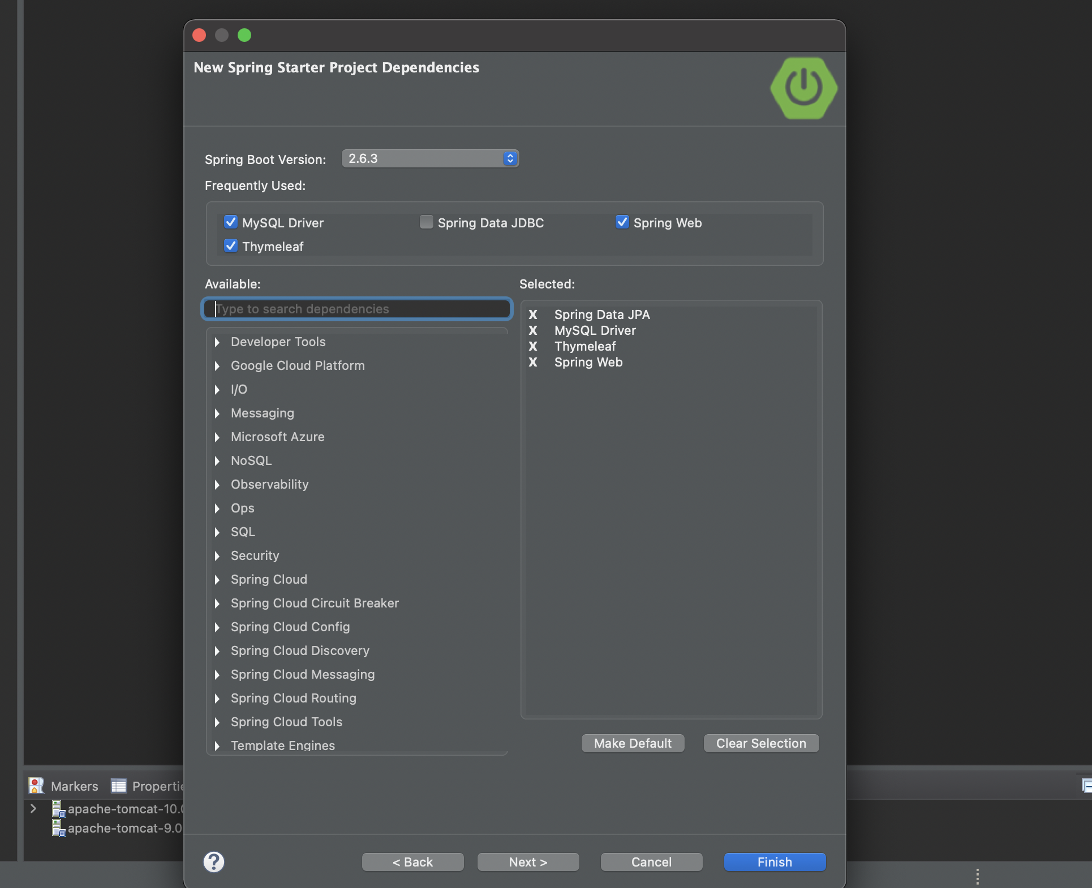
Create Spring Boot Project
Configure the dependencies for the Spring Boot project.
Notes:
Now, configure the dependencies for the Spring Boot Project
Spring Web - To develop Web app or webservices/microservices in a Spring Boot Application
Thymeleaf - server-side Java template engine for both web and standalone environments. Allows HTML to be displayed in browsers.
Spring Data JPA - To Persist data using JPA and Hibernate.
MySQL Driver - MySQL JDBC Type4 driver.
And finally, click on finish.

Slide 15

Create Spring Boot Project
Configure the dependencies for the Spring Boot project.
Spring Web - To develop web app or webservices/microservices in a Spring Boot application
Thymeleaf - Server-side Java template engine for both web and standalone environments that allows HTML to be displayed in browsers
Spring Data JPA - To persist data using JPA and Hibernate
MySQL Driver - MySQL JDBC Type4 driver
Notes:
Now, configure the dependencies for the Spring Boot Project
Spring Web - To develop Web app or webservices/microservices in a Spring Boot Application
Thymeleaf - server-side Java template engine for both web and standalone environments. Allows HTML to be displayed in browsers.
Spring Data JPA - To Persist data using JPA and Hibernate.
MySQL Driver - MySQL JDBC Type4 driver.
And finally, click on finish.

Slide 16
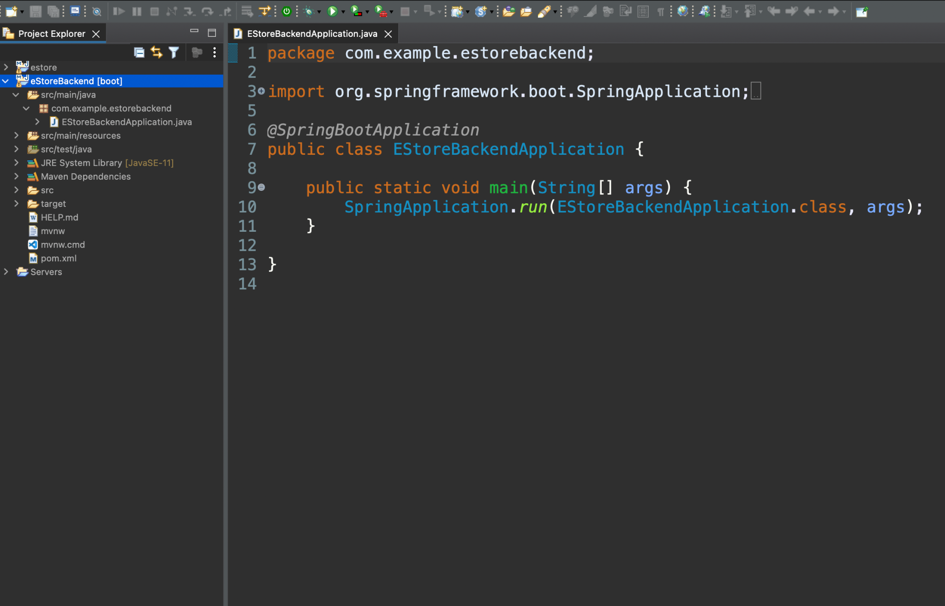
Spring Boot Project Structure
Spring Boot Project is the main class from where the execution begins.
This annotation is used to mark a configuration class that declares one or more @Bean methods and triggers auto-configuration and component scanning.
Notes:
Spring Boot Project gives you a main class from where the execution begins.
In our case its is EStoreBackendApplication.
@SpringBootApplication annotation is used to mark a configuration class that declares one or more @Bean methods and also triggers auto-configuration and component scanning.

Slide 17
Copy Existing Models into the Spring Boot Project

Slide 18
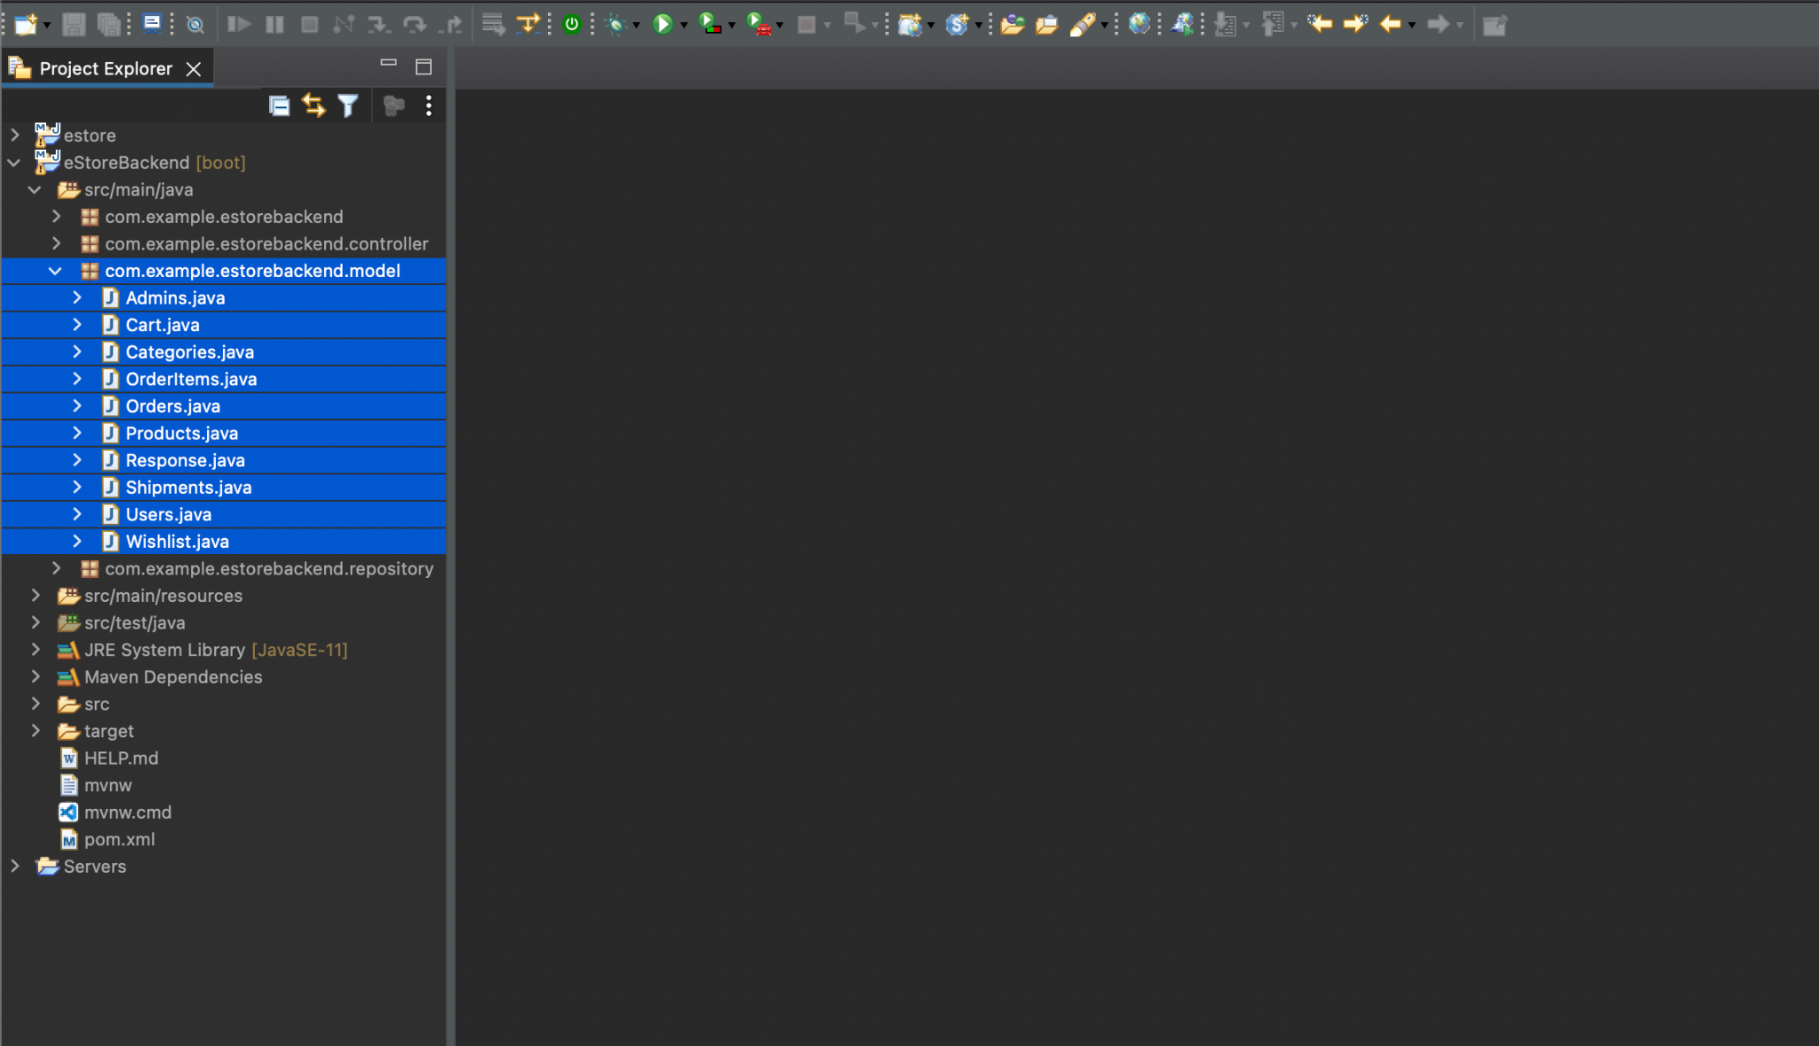
Copy the Models
Copy all the models into the model package, which is a child package of main package.
All the models must have getters, setters, and id as the attributes for primary key.
Notes:
Let us copy the below models from the previous project into our new project. Make sure all the models are copied into the model package which is a child package of our main package.
Also, all the models must have getters, setters and id as the attribute for primary key.

Slide 19
Copy the Models
Overview of the Model Classes
Function | Description
Admins.java | For the authentication of the admin users
Users.java | For the users registered on the backend
Categories.java | For the product categories
Orders.java | For the orders placed by the users
OrderItems.java | For the products available in an order placed by a user
Products.java | For the products along with their categories to be added by admin for end users
Shipments.java | For the placed order shipped for a user
Cart.java | For the shopping cart for a user
Wishlist.java | For the products wishlisted by a user
Notes:
Let us have a quick overview of the Model Classes.
Now we will create various POJO classes for the Admin as well as End User
Admins.java
For the Admin Authentication i.e. the Admin Users
Users.java
For the Users, registered on the Web Backend
Categories.java
For the Product Categories
Orders.java
For the Orders placed by the Users
OrderItems.java
For the products avaialble in an order placed by User
Products.java
The products alongwith Category to be added by admin for end users
Shipments.java
The placed order shipped for a User
Cart.java
The shopping cart for a User
Wishlist.java
The wish listed products by a User

Slide 20
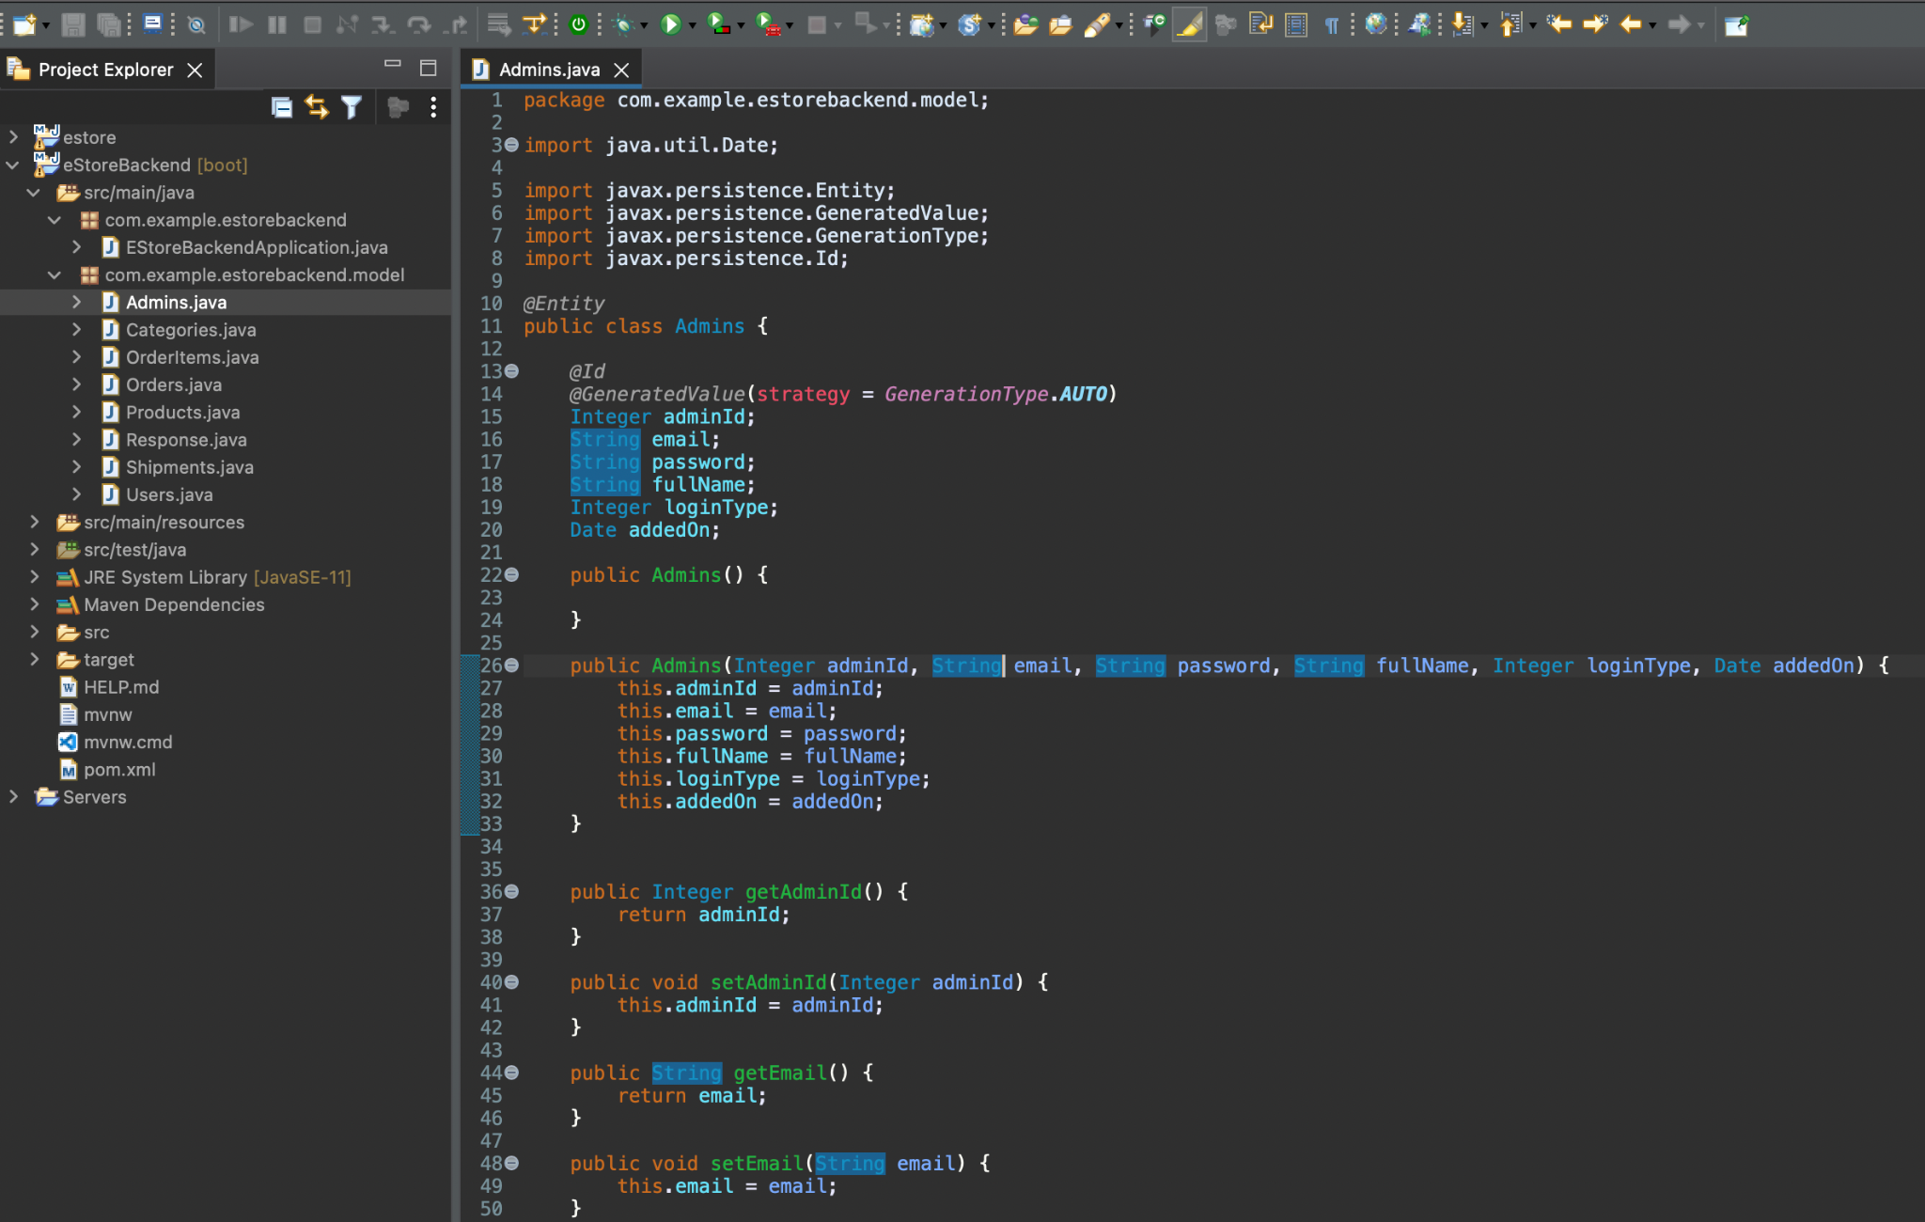
Annotate the Models
For DB connectivity, use the Spring Data JPA Dependency, which will perform the CRUD operations without the developer writing any JDBC or SQL Code.
@Entity: To mark class as an entity i.e., JPA shall create the table for that class.
@Id: To mark and attribute as a primary key. @Generatedvalue: for auto increment on primary key.
Notes:
For DB Connectivity, we are using the Spring Data JPA Dependency, which will perform the CRUD operations for us without the developer writing any JDBC or SQL Code. Let us annotate the model, with @Entity, @Id and @GeneratedValue annotations.
1. @Entity: To mark class as an entity i.e. JPA shall create the table for that class
2. @Id: To mark and attribute as a primary key
3. @GeneratedValue: For Auto Increment on Primary Key

Slide 21
Admins.java: with JPA Annotation
JPA will create the Admins Table automatically in the database with primary key as adminId and auto increment.
@Entity
public class Admins {
@Id
@GeneratedValue(strategy = GenerationType.AUTO)
Integer adminId;
String email;
String password;
String fullName;
Integer loginType;
Date addedOn;
//…
}
Notes:
Admins.java with annotations.
JPA will create the Admins Table automatically in the database with primary key as adminId and auto increment

Slide 22
Users.java: with JPA Annotation
@Entity
public class Users {
@Id
@GeneratedValue(strategy = GenerationType.AUTO)
Integer userId;
String email;
String password;
String fullName;
String street;
String city;
String state;
String country;
Integer pincode;
String image;
Long contact;
Date addedOn;
//…
}
JPA will create the Users Table automatically in the database with primary key as userId and auto increment.
Notes:
Admins.java with annotations.
JPA will create the Users Table automatically in the database with primary key as userId and auto increment

Slide 23
Categories.java: with JPA Annotation
JPA will create the Categories Table automatically in the database with primary key as userId and auto increment
@Entity
public class Categories {
@Id
@GeneratedValue(strategy = GenerationType.AUTO)
Integer categoryId;
String categoryName;
String categoryDescription;
String catgeoryImageUrl;
Integer active;
Date addedOn;
//…
}
Notes:
Categories.java with annotations.
JPA will create the Categories Table automatically in the database with primary key as userId and auto increment

Slide 24
Orders.java: with JPA Annotation
@Entity
public class Admins {
@Id
@GeneratedValue(strategy = GenerationType.AUTO)
Integer orderId;
Date orderDate;
String orderStatus;
Integer totalItems;
Double itemsSubTotal;
Double shipmentCharges;
Double totalAmount;
Integer paymentStatus;
String paymentStatusTitle;
Integer paymentMethod;
String paymentMethodTitle;
Integer userId;
String name;
String email;
Long contact;
String address; //…}
JPA will create the Orders Table automatically in the database with primary key as orderId and auto increment.
Notes:
Admins.java with annotations.
JPA will create the Orders Table automatically in the database with primary key as orderId and auto increment

Slide 25
OrderItems.java: with JPA Annotation
@Entity
public class OrderItems {
@Id
@GeneratedValue(strategy = GenerationType.AUTO)
Integer orderItemId;
Integer orderId;
Integer productId;
String productTitle;
String productDescription;
String productCode;
String productImg;
String productCategory;
Integer price;
Integer quantity;
Integer totalPrice;
//…
}
JPA will create the OrderItems Table automatically in the database with primary key as orderItemId and auto increment.
Notes:
Admins.java with annotations.
JPA will create the OrderItems Table automatically in the database with primary key as orderItemId and auto increment

Slide 26
Products.java: with JPA Annotation
JPA will create the Products Table automatically in the database with primary key as productId and auto increment.
@Entity
public class Products {
@Id
@GeneratedValue(strategy = GenerationType.AUTO)
Integer productId;
String productTitle;
String productDescription;
String productCode;
@ElementCollection
@CollectionTable(name = "Images", joinColumns = @JoinColumn(name = "id"))
@Column(name = "list")
List<String> images;
Integer categoryId;
Integer thumnailImage;
Integer price;
Date addedOn;
Integer rating;
//…
}
Notes:
Products.java with annotations.
JPA will create the Products Table automatically in the database with primary key as productId and auto increment

Slide 27
Shipments.java: with JPA Annotation
JPA will create the Shipments Table automatically in the database with primary key as shipmentId and auto increment.
@Entity
public class Shipments {
@Id
@GeneratedValue(strategy = GenerationType.AUTO)
Integer shipmentId;
Integer orderId;
Integer shipmentStatus;
String shipmentTitle;
Date shipmentDate;
String shipmentMethod;
String shipmentCompany;
Date expectedDeliveryDate;
//…
}
Notes:
Shipments.java with annotations.
JPA will create the Shipments Table automatically in the database with primary key as shipmentId and auto increment

Slide 28
Cart.java: with JPA Annotation
JPA will create the Cart Table automatically in the database with primary key as cartId and auto increment.
@Entity
public class Cart {
@Id
@GeneratedValue(strategy = GenerationType.AUTO)
Integer cartId;
Integer productId;
Integer userId;
//…
}
Notes:
Shipments.java with annotations.
JPA will create the Cart Table automatically in the database with primary key as cartId and auto increment

Slide 29
Wishlist.java: with JPA Annotation
JPA will create the Wishlist Table automatically in the database with primary key as wishListId and auto increment.
@Entity
public class Wishlist {
@Id
@GeneratedValue(strategy = GenerationType.AUTO)
Integer wishListId;
Integer productId;
Integer userId;
//…
}
Notes:
Shipments.java with annotations.
JPA will create the Wishlist Table automatically in the database with primary key as wishListId and auto increment

Slide 30
Create Response Model: Reponse.java
Copy the Response model for every request, and share the data to the client as a response with attributes like response code, message, and maybe some data.
public class Response<T> {
Integer code;
String message;
List<T> data;
public Response() {
// TODO Auto-generated constructor stub
}
public Response(Integer code, String message, List<T> data) {
this.code = code;
this.message = message;
this.data = data;
}
//….
}
The response contains code, message, and an optional data list if request is to get data.
Notes:
Also, copy the Response model so as for every request we can share the data to the client as a response with attributes like response code, message and may be some data
Response Object shall be sent back as a JSON to the client by servlets as a response.
It contains code, message and an optional data list if request is to get data.

Slide 31
Configure application.properties file
Notes:
In order to perform CRUD operations we are using Spring Data JPA dependency. It needs certain DB properties which we need to configure in application.properties file.

Slide 32
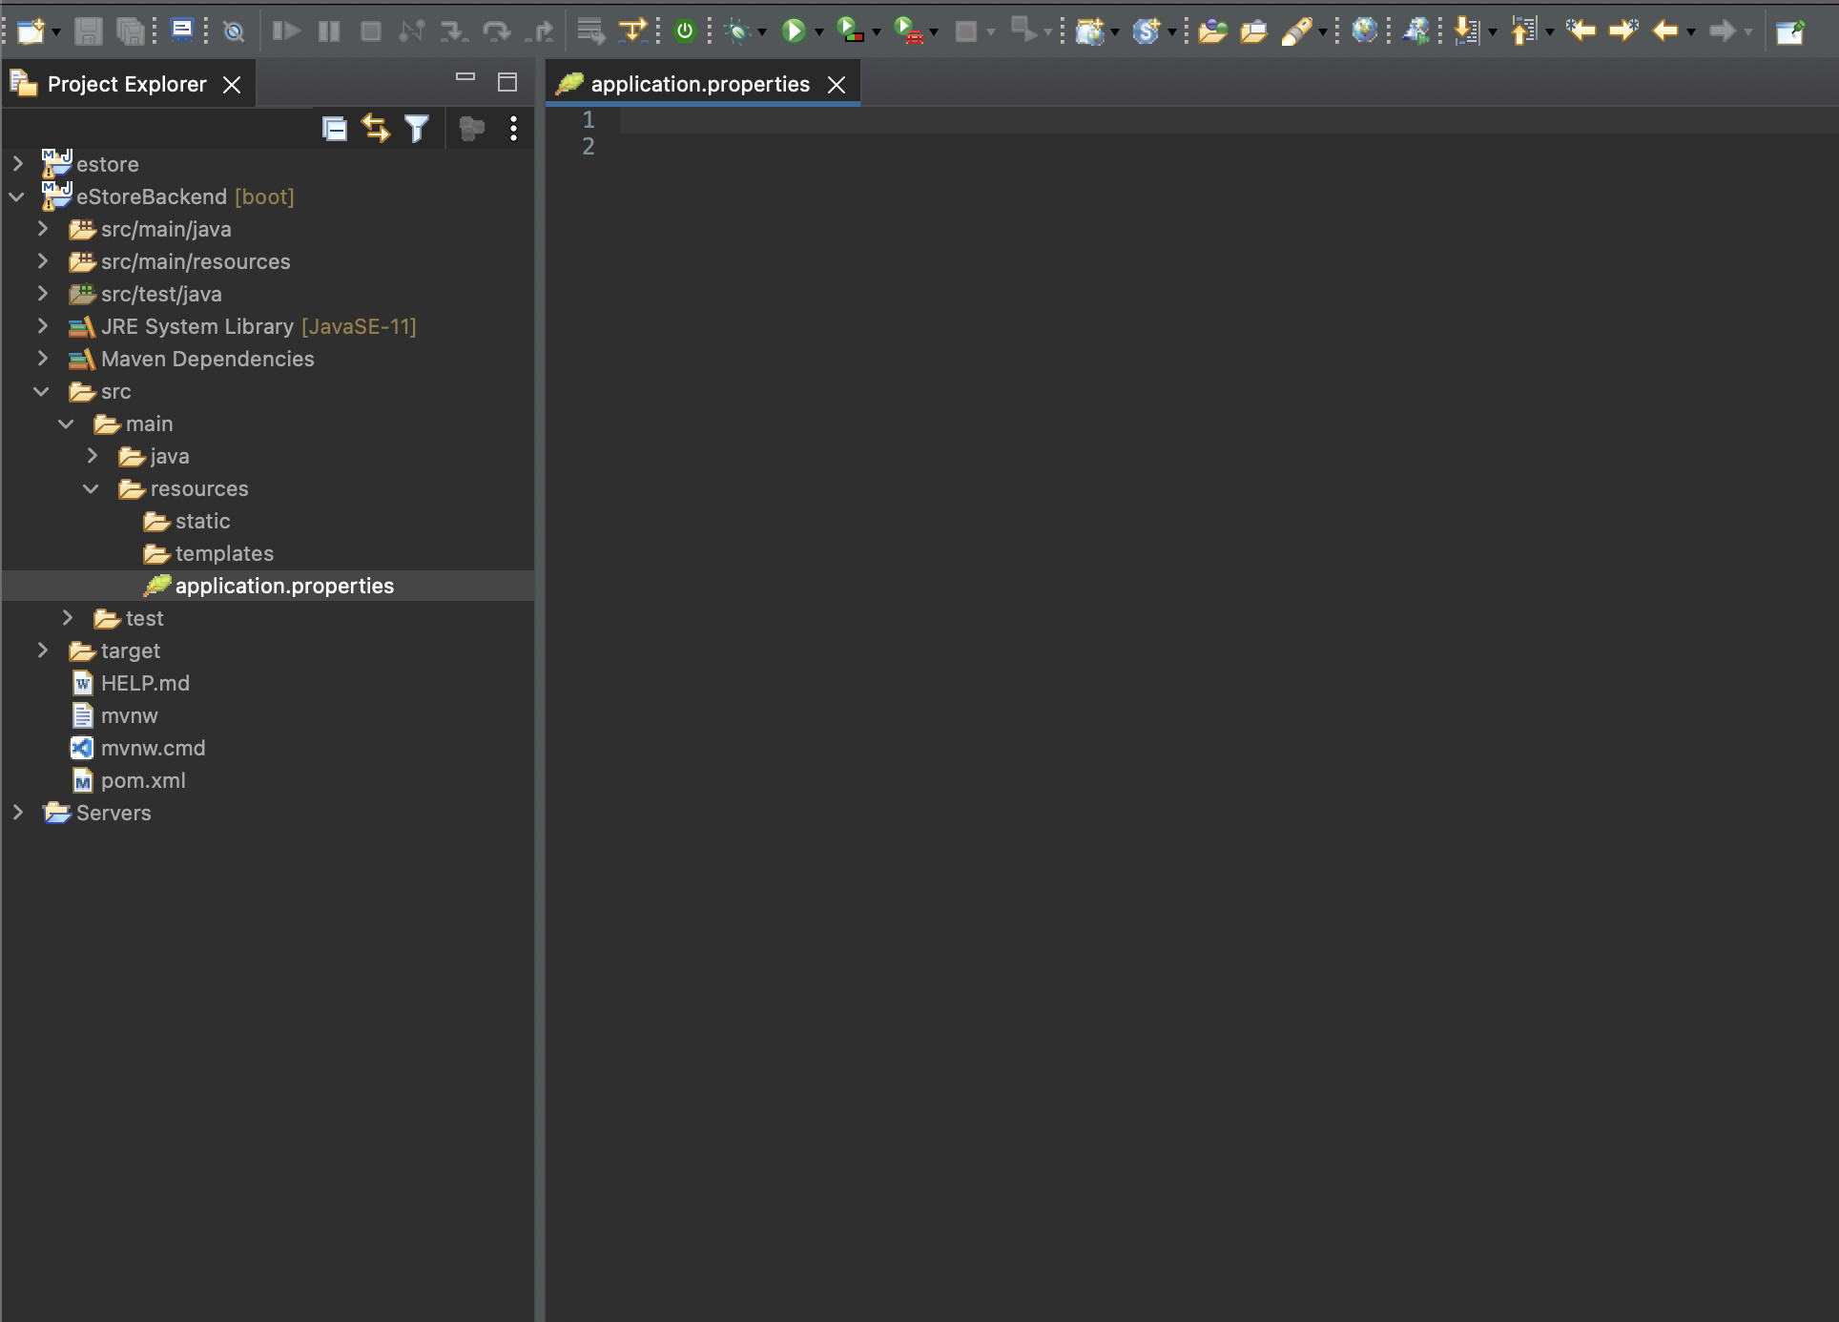
application.properties file for DB configuration
Navigate to src > main > resources > application.properties.
Add the parameters for Server Port Number and DB configuration.
Notes:
Navigate to src > main > resources > application.properties
It will be blank and now let us add the parameters for our Server Port Number and DB configuration

Slide 33
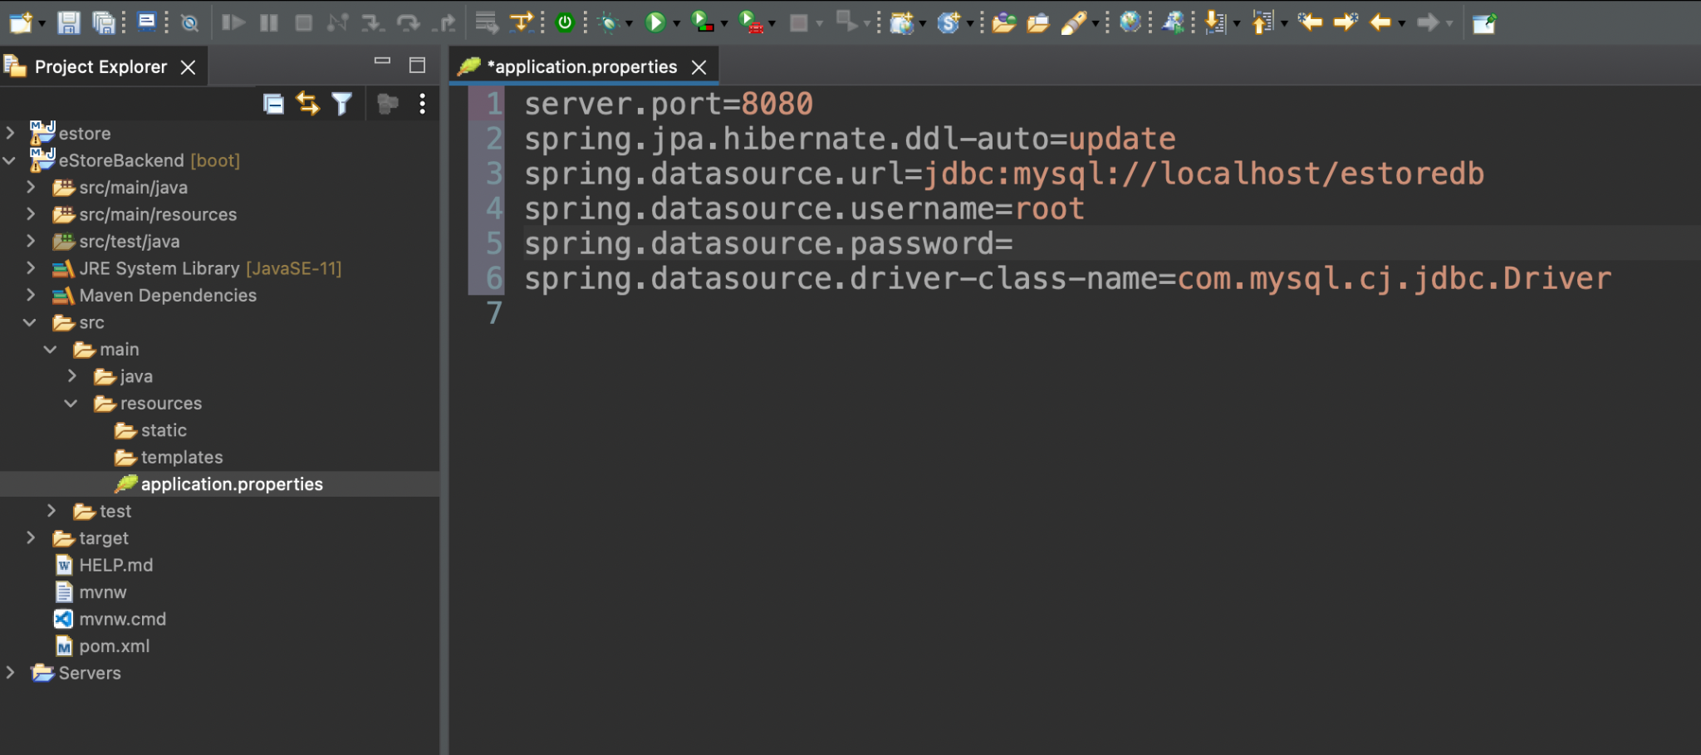
application.properties file for DB configuration
Define the port number on which Tomcat Web Server will run.
Notes:
Define the port number on which Tomcat Web Server will run
server.port=8080

Slide 34
application.properties file for DB configuration
Define JPA ddl property for table creation.
Notes:
Define JPA ddl property for table creation. It will create the table if not available and will update the records in case it is available
Spring.jpa.hibernate.ddl-auto=update

Slide 35
application.properties file for DB configuration
Define the DB URL.
Notes:
Define the DB URL
Spring.datasource.url=jdbc:mysql://localhost/estoredb

Slide 36
application.properties file for DB configuration
Define the DB User Password.
Notes:
Define the DB User Password (blank in our case)
Spring.datasource.password=

Slide 37
application.properties file for DB configuration
Define the Type4 Driver Class.
Notes:
Define the Type4 Driver Class
Spring.datasource.driver-class-name=com.mysql.cj.jdbc.Driver

Slide 38
Develop a Repository

Slide 39
Create a Repository
Notes:
In order to perform CRUD operations we need to create an interface as Repository which will extend CrudRepository from Springframework.data.repository package.

Slide 40
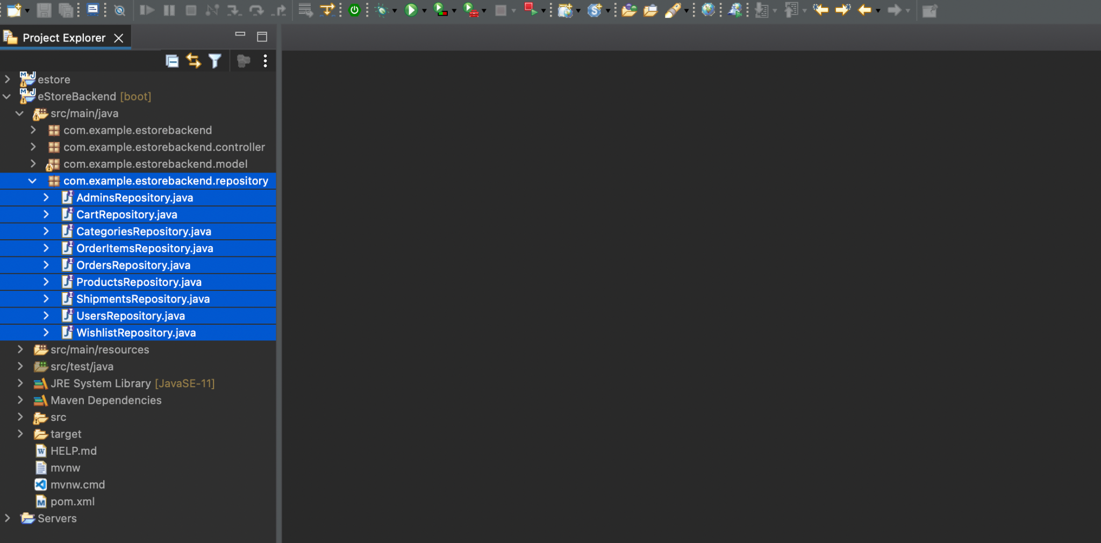
CrudRepository to Perform CRUD Operations
Create various interfaces that shall extend CrudRepository interface from Spring Data.
Notes:
Now, We will create various interfaces which shall extend CrudRepository interface from Spring Data

Slide 41
AdminsRepository.java: CrudRepository to Perform CRUD Operations
Create interface AdminsRepository in the package com.example.estorebackend.repository and extend CrudRepository with type Admins.
@Repository
public interface AdminsRepository extends CrudRepository<Admins, Integer>{
}
Notes:
Create interface AdminsRepository in the package com.example.estorebackend.repository and extend CrudRepository with type Admins

Slide 42
UsersRepository.java: CrudRepository to Perform CRUD Operations
Create interface UsersRepository in the package com.example.estorebackend.repository and extend CrudRepository with type Users.
@Repository
public interface UsersRepository extends CrudRepository<Users, Integer> {
}
Notes:
Create interface UsersRepository in the package com.example.estorebackend.repository and extend CrudRepository with type Users

Slide 43
CategoriesRepository.java: CrudRepository to Perform CRUD Operations
Create interface CategoriesRepository in the package com.example.estorebackend.repository and extend CrudRepository with type Categories.
@Repository
public interface CategoriesRepository extends CrudRepository<Categories, Integer> {
}
Notes:
Create interface CategoriesRepository in the package com.example.estorebackend.repository and extend CrudRepository with type Categories

Slide 44
ProductsRepository.java: CrudRepository to Perform CRUD Operations
Create interface ProductsRepository in the package com.example.estorebackend.repository and extend CrudRepository with type Products.
@Repository
public interface ProductsRepository extends CrudRepository<Products, Integer> {
}
Notes:
Create interface ProductsRepository in the package com.example.estorebackend.repository and extend CrudRepository with type Products

Slide 45
OrdersRepository.java: CrudRepository to Perform CRUD Operations
Create interface OrdersRepository in the package com.example.estorebackend.repository and extend CrudRepository with type Orders.
@Repository
public interface OrdersRepository extends CrudRepository<Orders, Integer> {
}
Notes:
Create interface OrdersRepository in the package com.example.estorebackend.repository and extend CrudRepository with type Orders

Slide 46
OrderItemsRepository.java: CrudRepository to Perform CRUD Operations
Create interface OrderItemsRepository in the package com.example.estorebackend.repository and extend CrudRepository with type OrderItems.
@Repository
public interface OrderItemsRepository extends CrudRepository<OrderItems, Integer> {
}
Notes:
Create interface OrderItemsRepository in the package com.example.estorebackend.repository and extend CrudRepository with type OrderItems

Slide 47
ShipmentsRepository.java: CrudRepository to Perform CRUD Operations
Create interface ShipmentsRepository in the package com.example.estorebackend.repository and extend CrudRepository with type Shipment.
@Repository
public interface ShipmentsRepository extends CrudRepository<Shipments, Integer> {
}
Notes:
Create interface ShipmentsRepository in the package com.example.estorebackend.repository and extend CrudRepository with type Shipment

Slide 48
CartRepository.java: CrudRepository to Perform CRUD Operations
Create interface CartRepository in the package com.example.estorebackend.repository and extend CrudRepository with type Cart.
@Repository
public interface CartRepository extends CrudRepository<Cart, Integer> {
}
Notes:
Create interface CartRepository in the package com.example.estorebackend.repository and extend CrudRepository with type Cart

Slide 49
WishlistRepository.java: CrudRepository to Perform CRUD Operations
Create interface WishlistRepository in the package com.example.estorebackend.repository and extend CrudRepository with type Wishlist.
@Repository
public interface WishlistRepository extends CrudRepository<Wishlist, Integer> {
}
Notes:
Create interface WishlistRepository in the package com.example.estorebackend.repository and extend CrudRepository with type Wishlist

Slide 50
Build and Execute

Slide 51
Create HTML Page

Slide 52
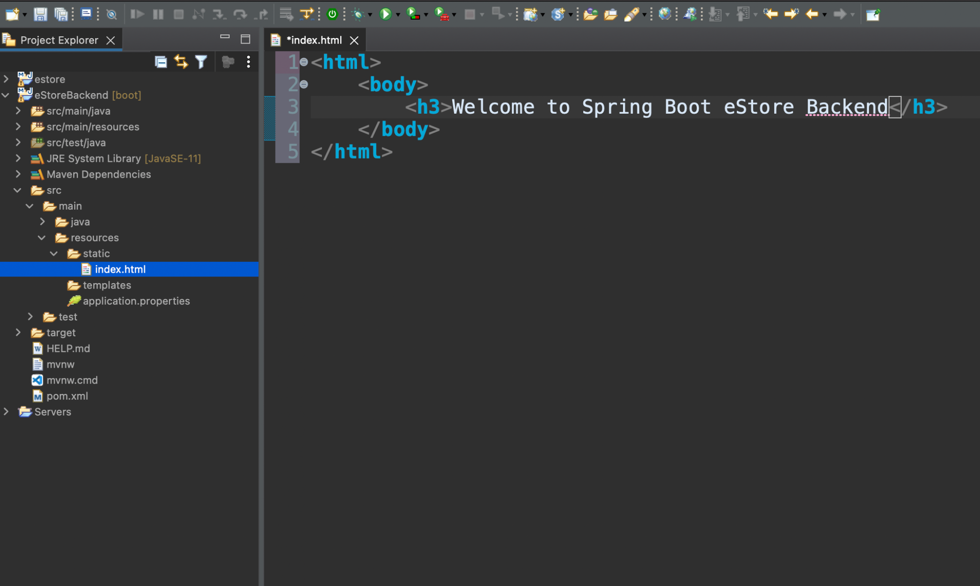
Create index.html Web Page
Go to src > main > resources > static and create index.html web page.
Notes:
In order to build and execute the app, let us create index.html welcome page.
Go to src > main > resources > static
and create index.html web page

Slide 53
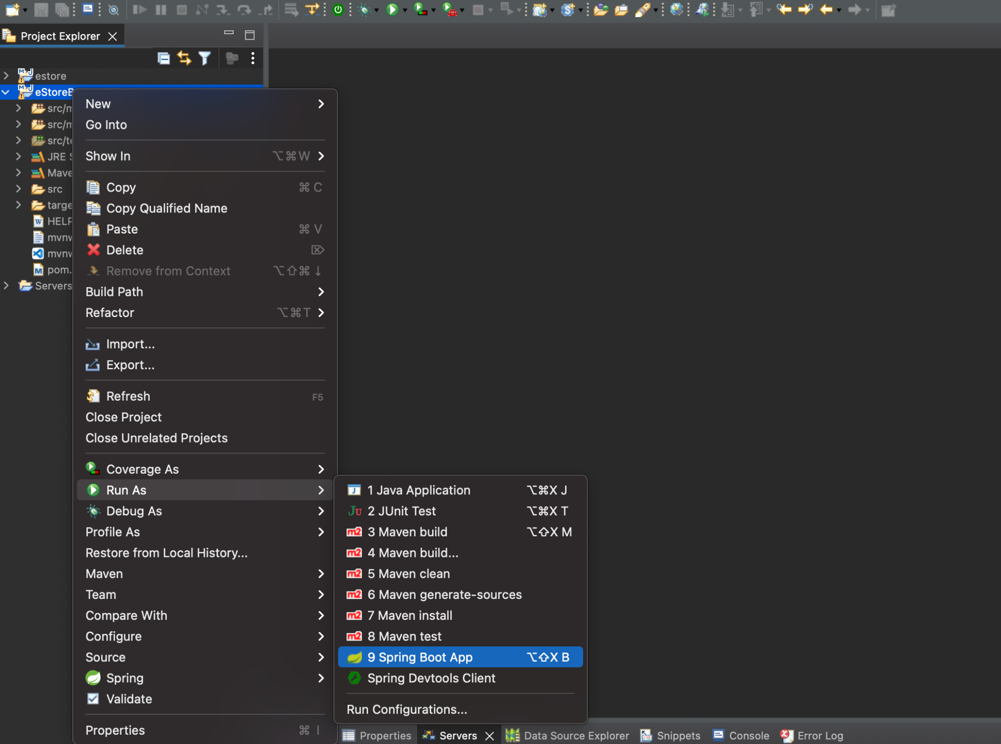
Run the Project as Spring Boot App
right-click on the project and run as Spring Boot App.
OR
Click on run icon and select run as Spring Boot app.
Notes:
Right click on the project and run as Spring Boot App
Or
Simply click the run icon and select run as Spring Boot app

Slide 54
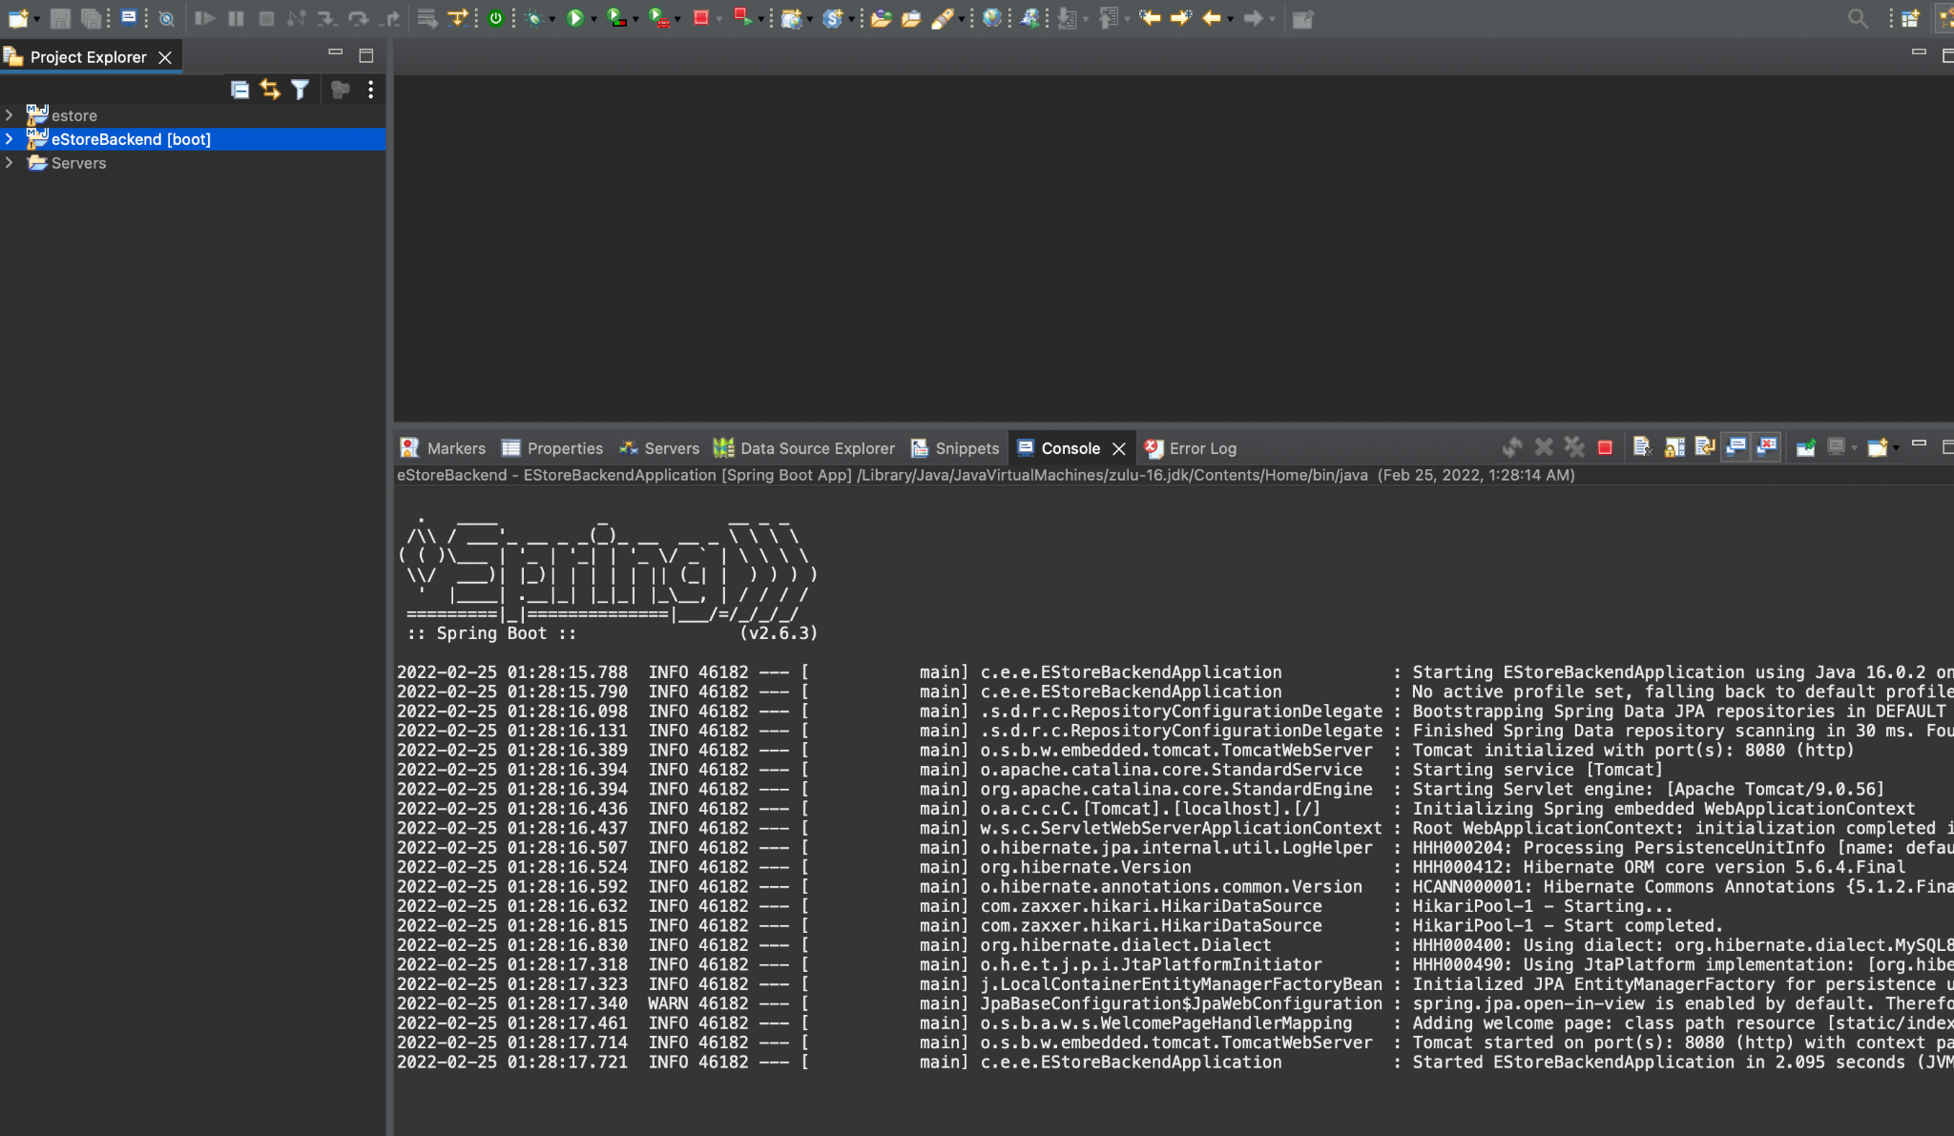
Project Run Output Logs
Check in the console if the application is running successfully on Tomcat Port 8080.
In case 8080 port is blocked, go to application.properties file and change the server port number.
Notes:
Check in the console if the application is running successfully on Tomcat Port 8080.
In case 8080 port is blocked, go to application.properties file and change the server port number

Slide 55
Execute the Project on Tomcat 8080

Slide 56
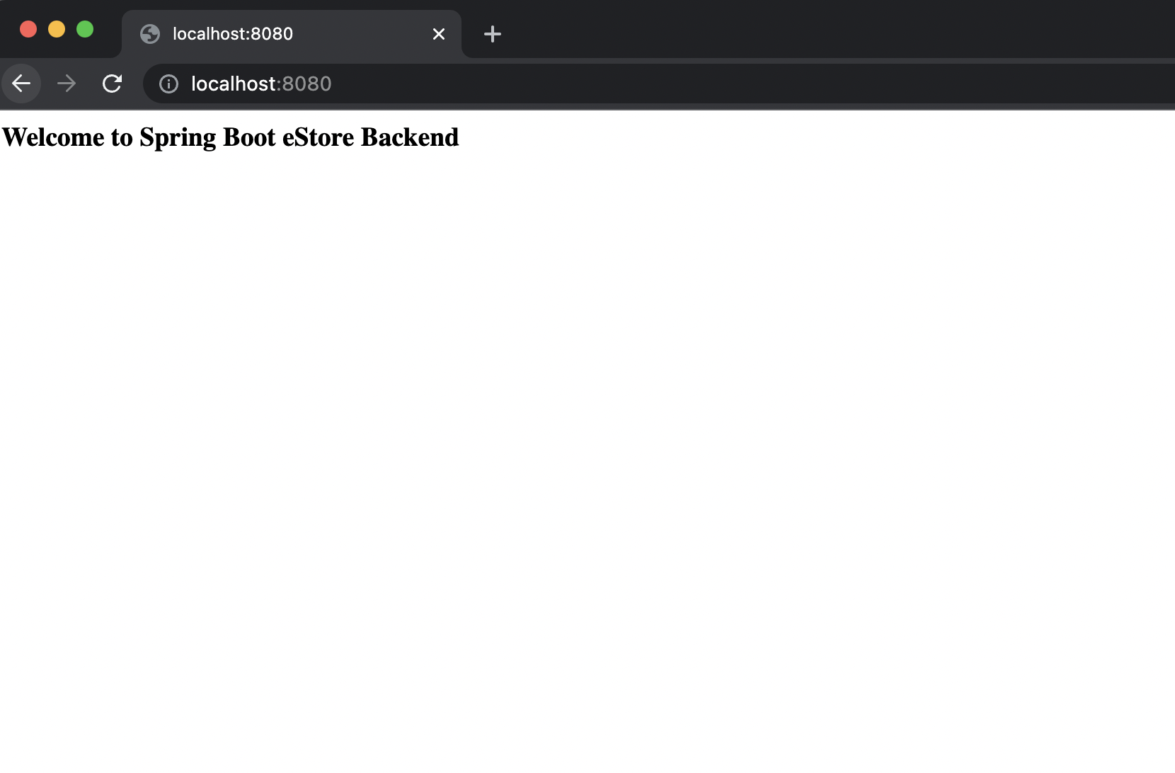
Project on localhost:8080
Open the web browser and type localhost:808. index.html web page will be loaded automatically.
Notes:
Open the web browser and type localhost:8080, index.html web page will be loaded automatically

Slide 57
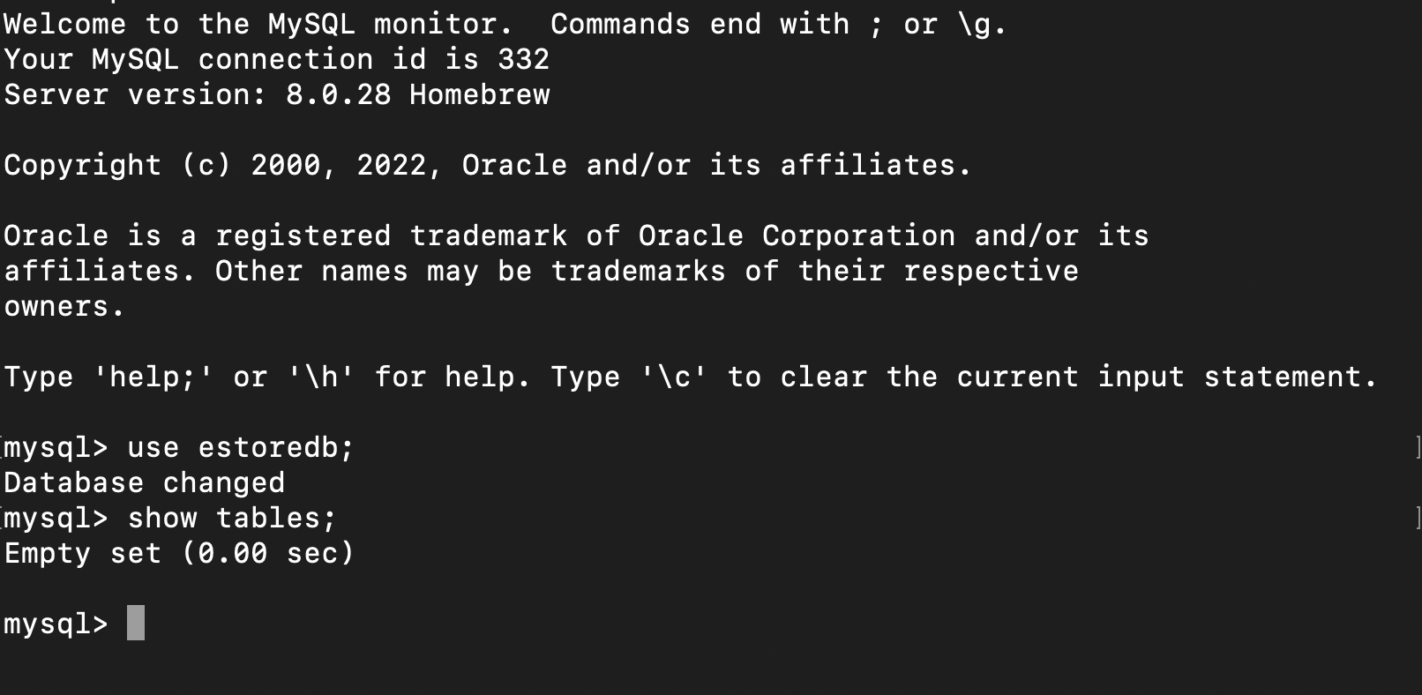
MySQL Before Spring Boot App Execution
In the database estoredb, no table exists.
Notes:
In the database estoredb, no table exists

Slide 58
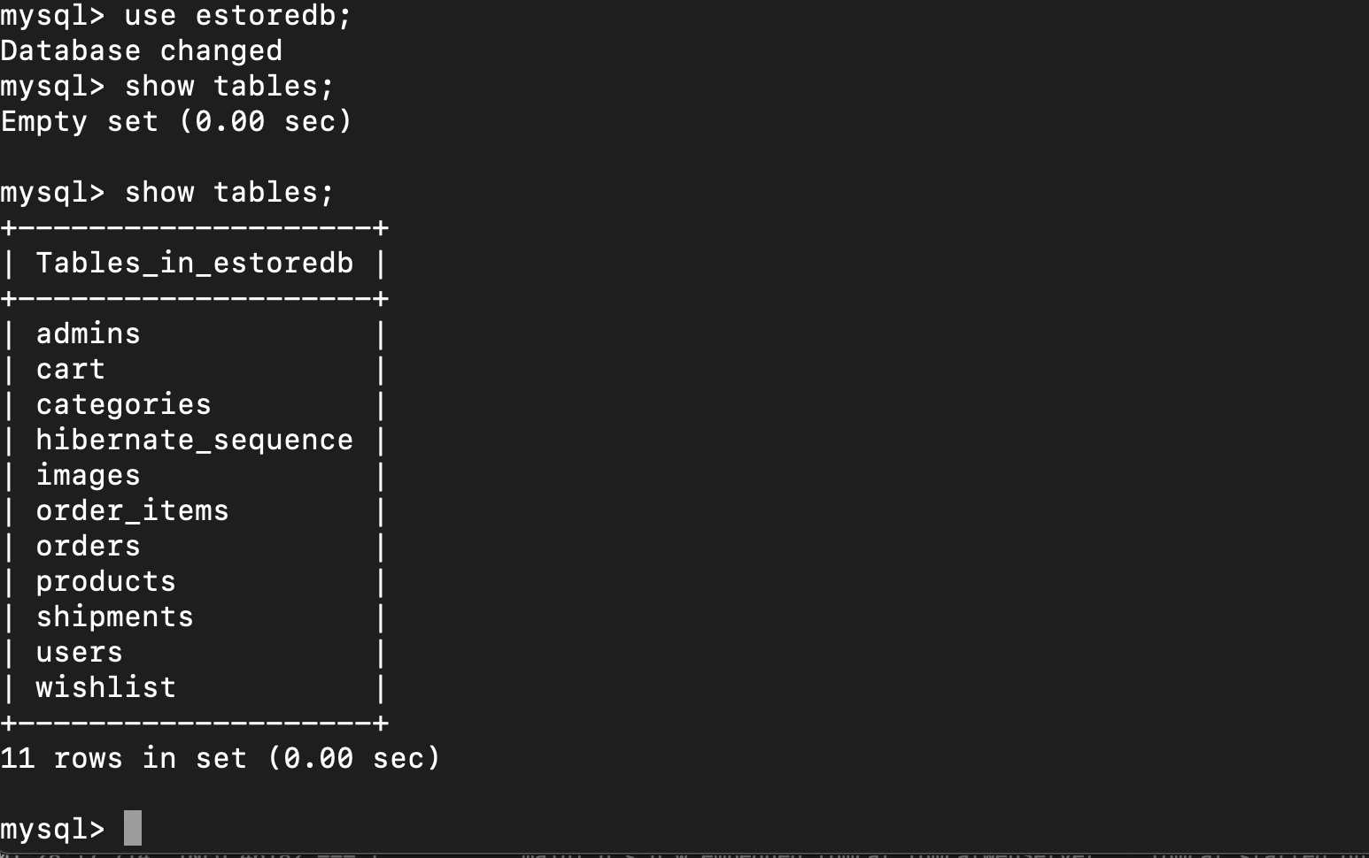
MySQL After Spring Boot App Execution
In the database estoredb, all tables are created automatically by JPA.
Notes:
In the database estoredb, all tables are created automatically by JPA

Slide 59
Spring Boot is used to create and configure Spring Boot Project.
JPA annotations are used to create various model class.
CrudRepository interfaces is created for DB operations for various models.
Project is built and executed to check the database structure.

Slide 61
Which of the following dependencies is required for DB operations in Spring
Boot?
01
Spring Web
Thymeleaf
Spring Data JPA
JUnit

Slide 62
Which of the following dependencies is required for DB operations in Spring
Boot?
01
Spring Web
Thymeleaf
Spring Data JPA
JUnit
C
Use Spring Data JPA to use CrudRepository and Annotations for Persistence.

Slide 63
Which annotation marks the primary key?
02
Entity
Id
GeneratedValue
Column

Slide 64
Which annotation marks the primary key?
02
Entity
Id
GeneratedValue
Column
B
@Id Annotation marks the Attribute as a primary key in Table.

Slide 65
Which interface needs to be extended for creating Repository for DB operations?
03
SQLRepository
MySQLRepository
CrudRepository
DBRepository

Slide 66
Which interface needs to be extended for creating a repository for DB operations?
03
SQLRepository
MySQLRepository
CrudRepository
DBRepository
C
Interface MyRepository should extend CrudRepository<T, DT>.

Slide 67
Where do we configure the properties of DB?
04
web.xml
application.properties
pom.xml
Java Class

Slide 68
Where do we configure the properties of DB?
04
web.xml
application.properties
pom.xml
Java Class
B
Configure the properties for DB like url, username and password in application.properties file.

Slide 69
Which property is used to change the port number of Tomcat?
05
server.port
tomcat.port
server-port
tomcat-port

Slide 70
Which property is used to change the port number of Tomcat?
05
server.port
tomcat.port
server-port
tomcat-port
A
Set server.port=8080 or any other port in application.properties file to change the port number of Tomcat.

Slide 71
Before the Next Class
You have successfully completed this session. Before the next discussion, you should go through:
Spring Boot
Web Services

Slide 72
What’s Next?
We have finished our Classes and Design Pattern for the Backend Project with the End Usermodule. In our next live session, we will :
Explore how to create RestControllers
Implement MicroServices for CRUD Operations
Test web services for Request and Response in Postman
Package the Project using Maven wrapper

